Slide 1
Session 08: Web
Visual Studio 2017
By Michael Washington

Slide 2
About
Michael Washington
Microsoft MVP
Microsoft Certified Professional
AiHelpWebsite.com
LightSwitchHelpWebsite.com
HoloLensHelpWebsite.com

Slide 3
Agenda
JavaScriptServices – Create a Angular 2+ JavaScriptServices project
Live Editing – Demonstrate editing Angular code without reloading the web browser
Add external libraries – Incorporate the PrimeNg Angular 2+ library and update Webpack
Add A Database / Entity Framework – The steps to create a database driven application

Slide 4
JavaScriptServices

Slide 5
JavaScriptServices
JavaScriptServices is a set of technologies for ASP.NET Core developers. It provides infrastructure that you'll find useful if you use Angular 2 / React / Knockout / etc. on the client, or if you build your client-side resources using Webpack, or otherwise want to execute JavaScript on the server at runtime.
Invoking arbitrary NPM packages at runtime from .NET code (docs)
Server-side prerendering of SPA components (docs)
Webpack dev middleware (docs)
Hot module replacement (HMR) (docs)
Server-side and client-side routing integration (docs)
Server-side and client-side validation integration
"Cache priming" for Angular 2 apps

Slide 6
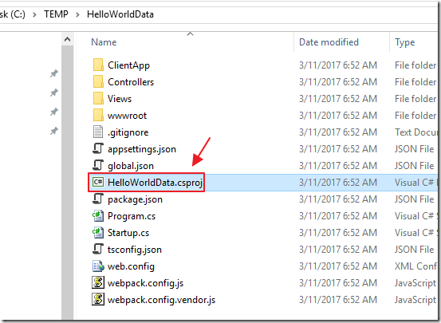
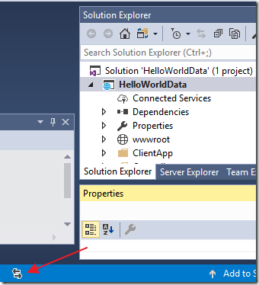
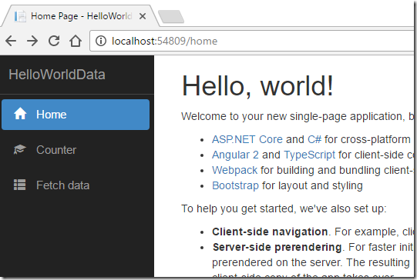
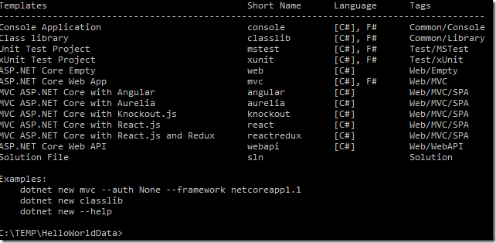
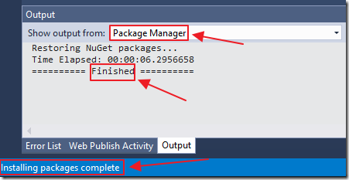
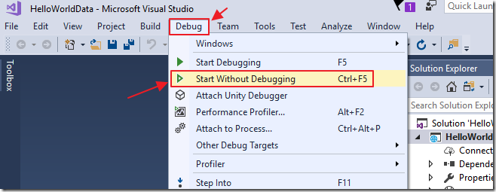
JavaScriptServices

Slide 7
JavaScriptServices

Slide 8
Live Editing

Slide 9
External Libraries

Slide 10
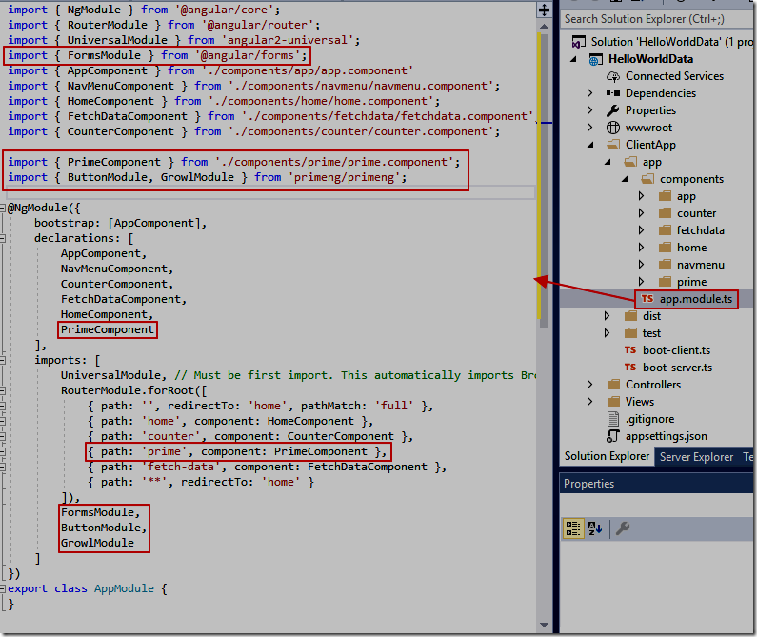
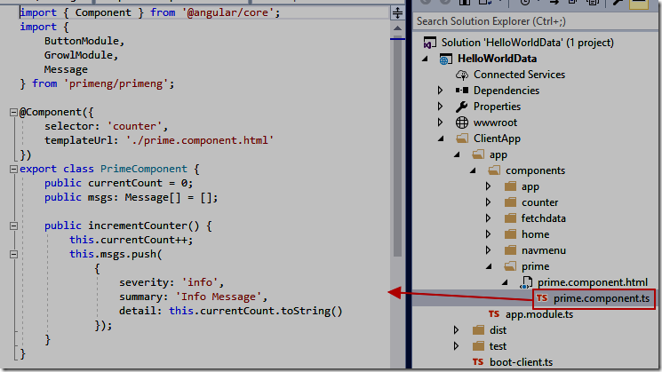
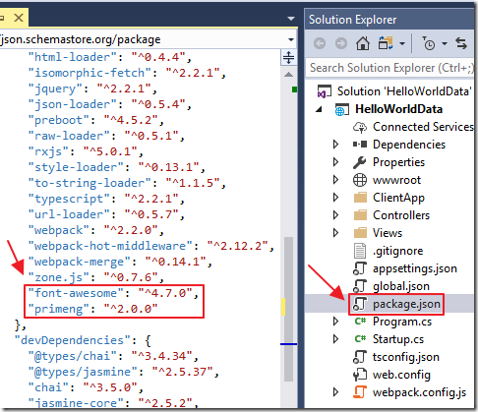
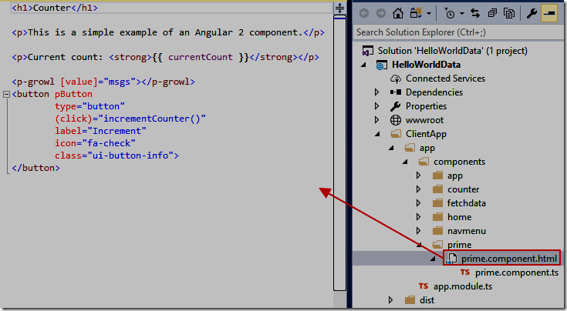
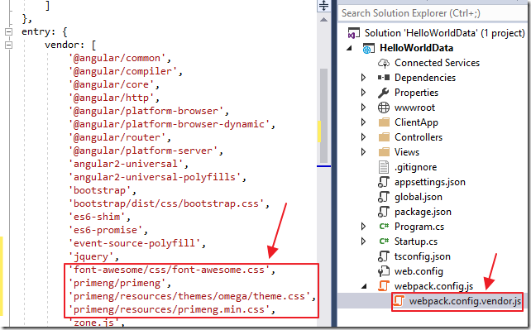
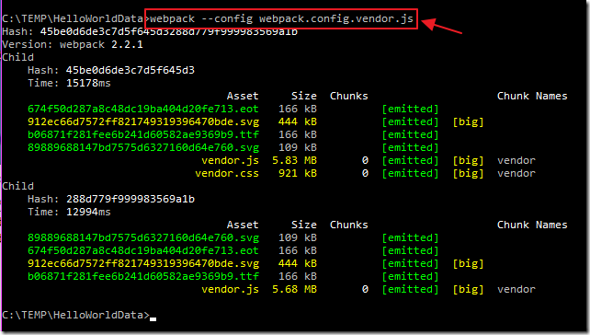
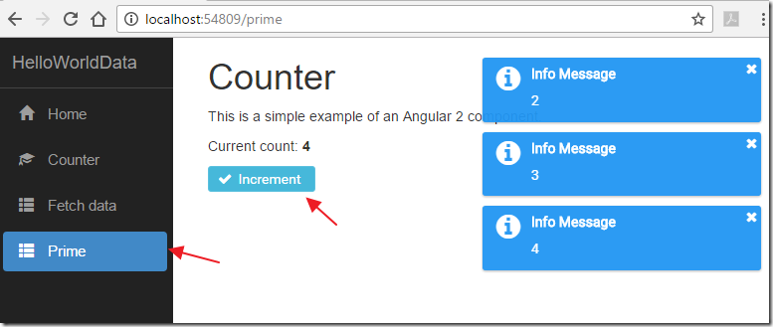
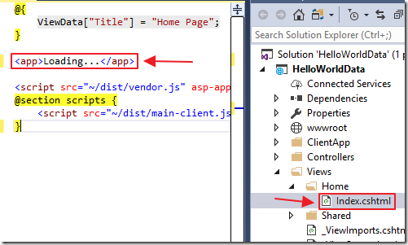
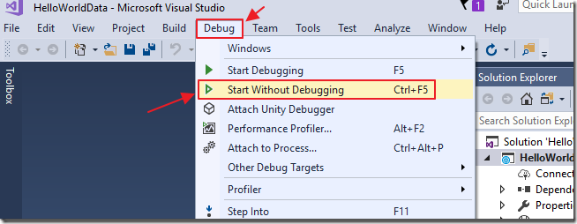
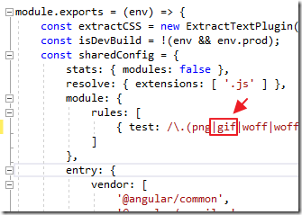
External Library

Slide 11
External Library

Slide 12
Add A Database / Entity Framework

Slide 13
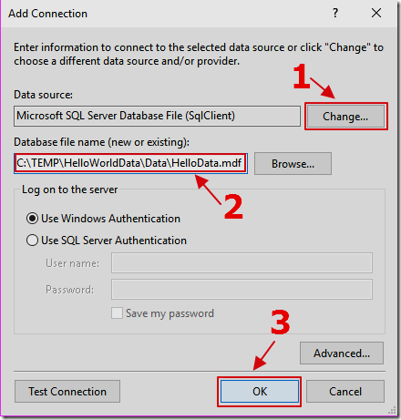
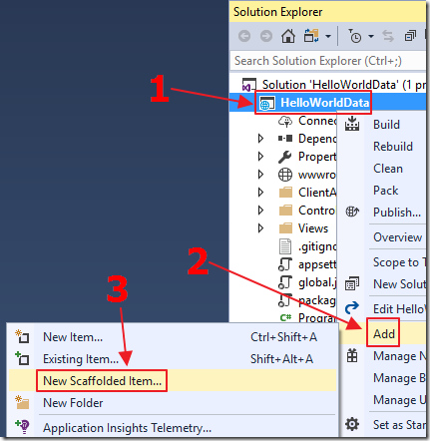
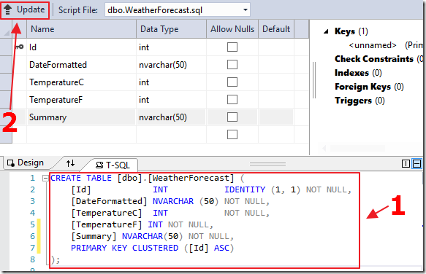
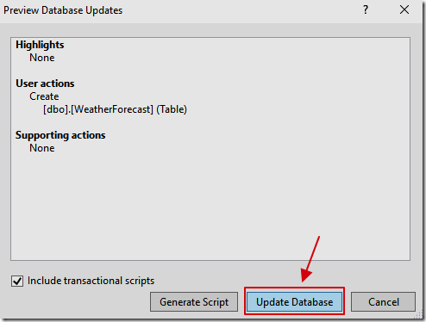
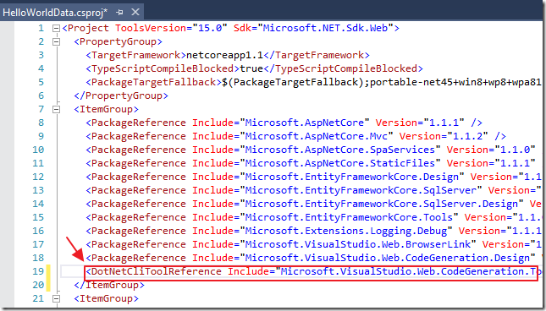
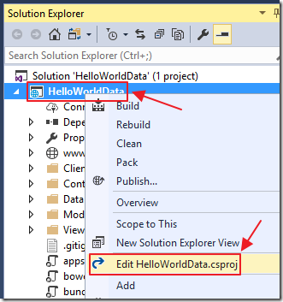
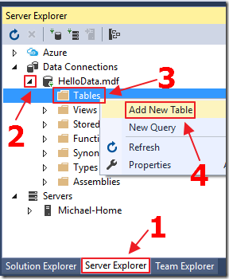
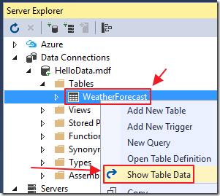
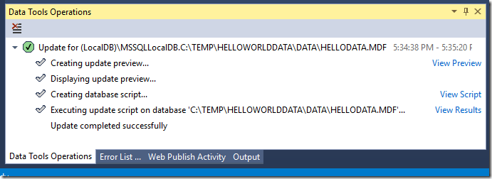
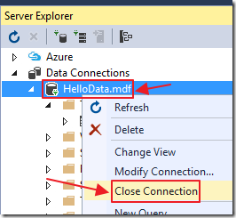
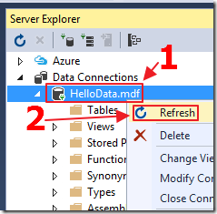
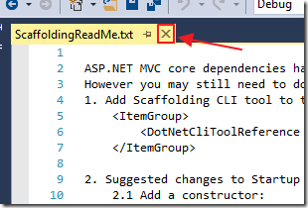
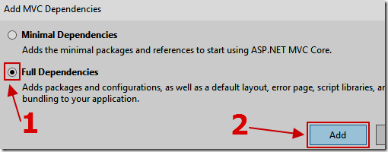
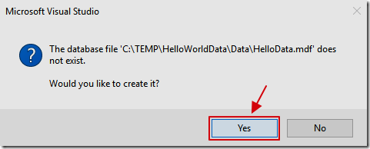
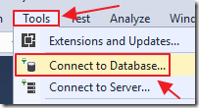
Add A Database

Slide 14
Add A Database

Slide 15
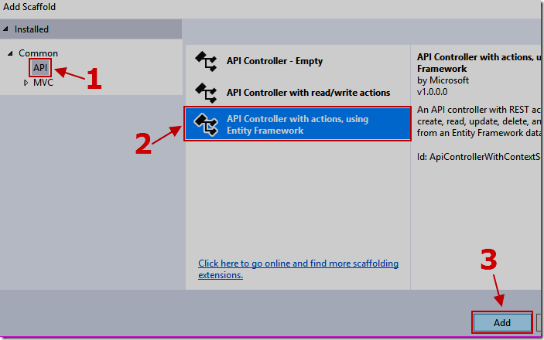
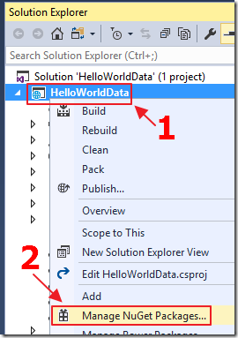
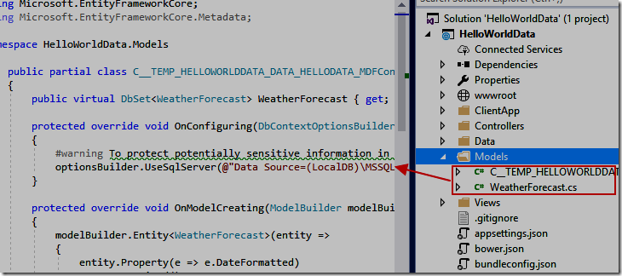
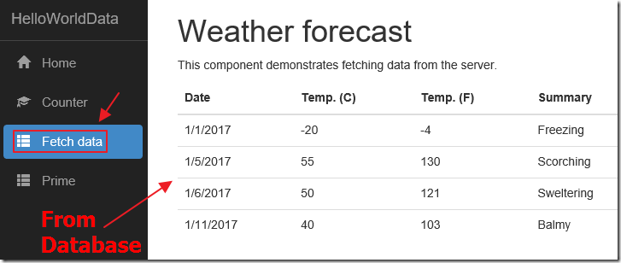
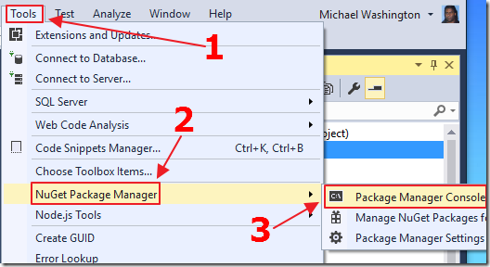
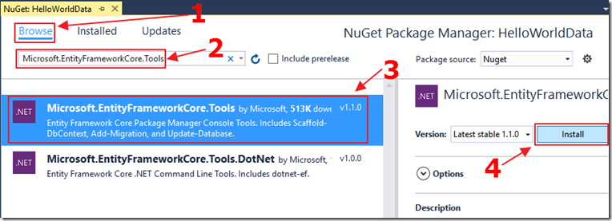
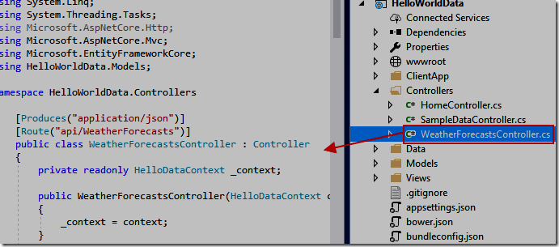
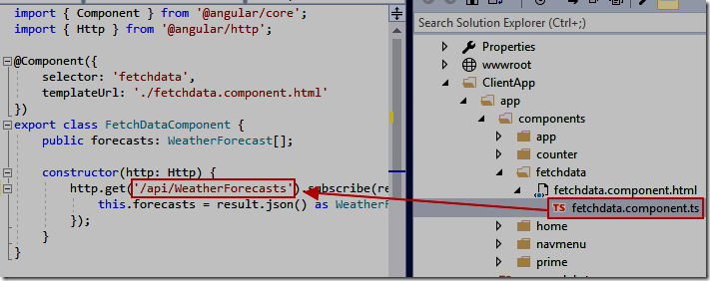
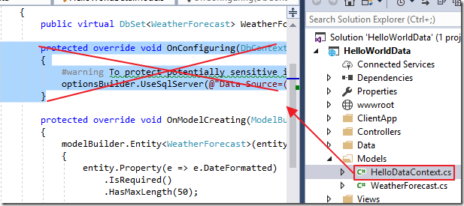
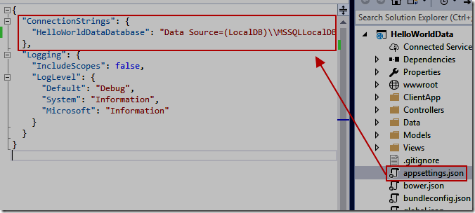
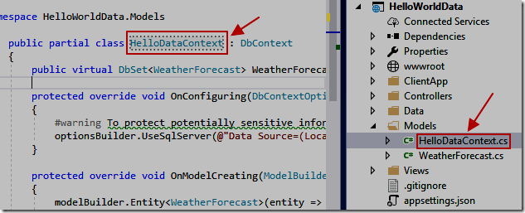
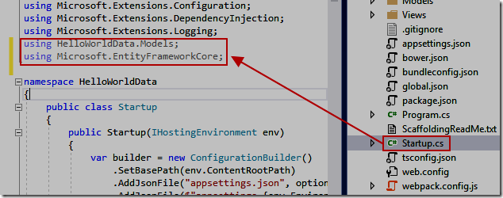
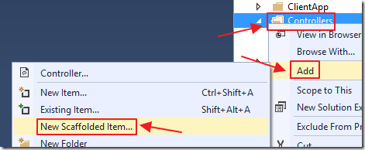
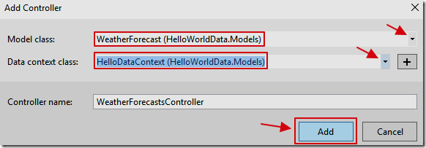
Add Entity Framework

Slide 16
Entity Framework

Slide 17
JavaScriptServices
Live Editing
Add External Libraries (PrimeNG)
Add A Database / Entity Framework

Slide 18
Links
Full Tutorial and code download http://lightswitchhelpwebsite.com/Blog/tabid/61/EntryId/3304/Hello-World-Angular-2-Data-Sample-Using-JavaScriptServices-Net-Core-and-PrimeNg.aspx
Building Single Page Applications on ASP.NET Core with JavaScriptServices https://blogs.msdn.microsoft.com/webdev/2017/02/14/building-single-page-applications-on-asp-net-core-with-javascriptservices/
ASP.NET Core - New Database https://docs.microsoft.com/en-us/ef/core/get-started/aspnetcore/new-db
ASP.NET Core - Existing Database https://docs.microsoft.com/en-us/ef/core/get-started/aspnetcore/existing-db

